Slide 1
Time Series Analysis
Temprature of Toronto
Presentation By:
M. Usman
Mirza Kashif

Slide 2
Data
Monthly temperature of Toronto, Canada
Fahrenheit
Time series data (2012 – 2020)
Seasonal Data
Source: National Centers for Environmental Information

Slide 3
Data
 | 2012 | 2013 | 2014 | 2015 | 2016 | 2017 | 2018 | 2019 | 2020 | 2021
Jan | 36.68 | 36.52 | 26.16 | 27.93 | 33.76 | 35.39 | 30.94 | 29.74 | 36.27 | 33.58
Feb | 38.76 | 31.96 | 26.79 | 19.36 | 36.90 | 39.46 | 37.30 | 33.25 | 34.31 | 30.79
Mar | 53.48 | 40.55 | 34.52 | 37.42 | 44.55 | 38.54 | 39.88 | 38.55 | 45.32 | 48.06
Apr | 54.60 | 51.73 | 51.79 | 54.53 | 49.88 | 56.86 | 46.76 | 51.52 | 50.97 | 53.97
May | 71.10 | 69.00 | 66.03 | 70.65 | 68.65 | 61.25 | 71.68 | 61.61 | 62.77 | 67.10
Jun | 78.43 | 74.03 | 76.33 | 72.46 | 77.97 | 74.76 | 74.79 | 73.53 | 79.13 | 79.10
Jul | 84.84 | 80.07 | 77.23 | 80.10 | 84.06 | 78.58 | 82.75 | 82.52 | 86.39 | 77.50
Aug | 80.16 | 78.33 | 76.85 | 77.45 | 84.40 | 76.81 | 81.13 | 78.27 | 80.53 | 82.97
Sep | 70.93 | 69.30 | 70.97 | 75.70 | 75.62 | 74.83 | 73.83 | 71.57 | 71.00 | 73.07
Oct | 57.90 | 60.69 | 59.03 | 57.81 | 60.90 | 64.97 | 55.74 | 59.16 | 56.59 | 62.23
Nov | 45.53 | 43.90 | 42.76 | 51.81 | 52.48 | 46.46 | 40.52 | 41.10 | 52.03 | 47.64
Dec | 40.55 | 30.66 | 37.93 | 45.57 | 36.07 | 30.42 | 38.07 | 38.13 | 37.90 | 41.58

Slide 4
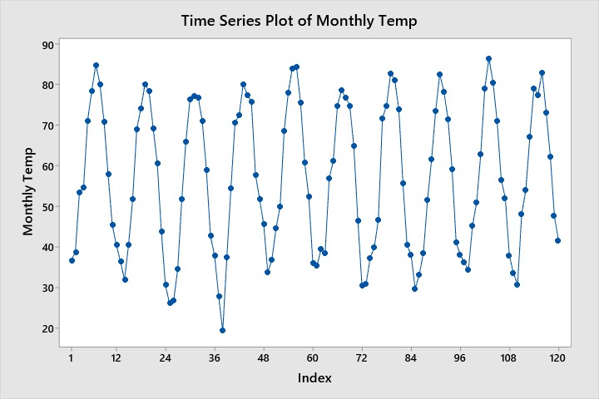
Time Series Plot

Slide 5
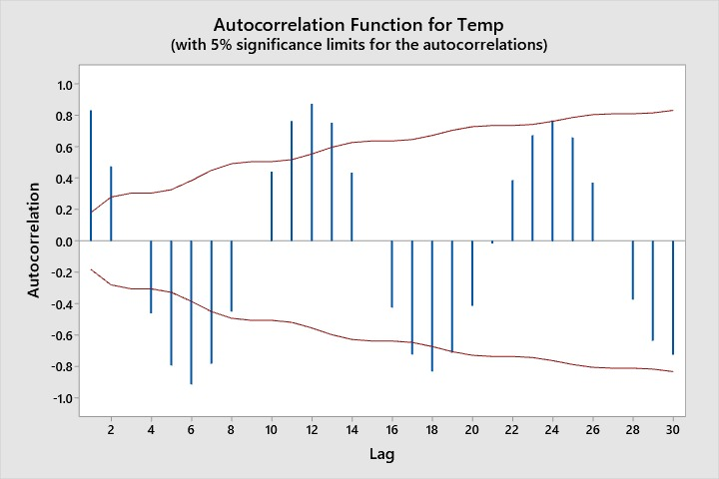
Autocorrelation
Notes:
Data is not Stationary

Slide 6
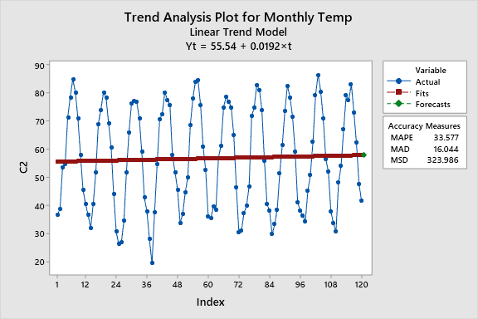
Trend
Notes:
Global warming

Slide 7
Descriptive Stats
 | Mean | Std Dev | Variance | MIN VALUE | MAX VALUE | MEDIAN | Skewness | Kurtosis | N
2012 | 59.41 | 16.48 | 271.71 | 36.68 | 84.84 | 56.25 | 0.11 | -1.55 | 12.00
2013 | 55.56 | 17.73 | 314.32 | 30.66 | 80.07 | 56.21 | -0.04 | -1.74 | 12.00
2014 | 53.87 | 18.94 | 358.57 | 26.16 | 77.23 | 55.41 | -0.15 | -1.68 | 12.00
2015 | 55.90 | 19.41 | 376.83 | 19.36 | 80.10 | 56.17 | -0.50 | -0.90 | 12.00
2016 | 58.77 | 18.24 | 332.62 | 33.76 | 84.40 | 56.69 | 0.07 | -1.64 | 12.00
2017 | 56.53 | 17.09 | 291.95 | 30.42 | 78.58 | 59.06 | -0.14 | -1.71 | 12.00
2018 | 56.12 | 18.59 | 345.71 | 30.94 | 82.75 | 51.25 | 0.19 | -1.88 | 12.00
2019 | 54.91 | 17.91 | 320.74 | 29.74 | 82.52 | 55.34 | 0.12 | -1.61 | 12.00
2020 | 57.77 | 17.41 | 303.05 | 34.31 | 86.39 | 54.31 | 0.26 | -1.32 | 12.00
2021 | 58.13 | 17.33 | 300.42 | 30.79 | 82.97 | 58.10 | -0.11 | -1.41 | 12.00

Slide 8
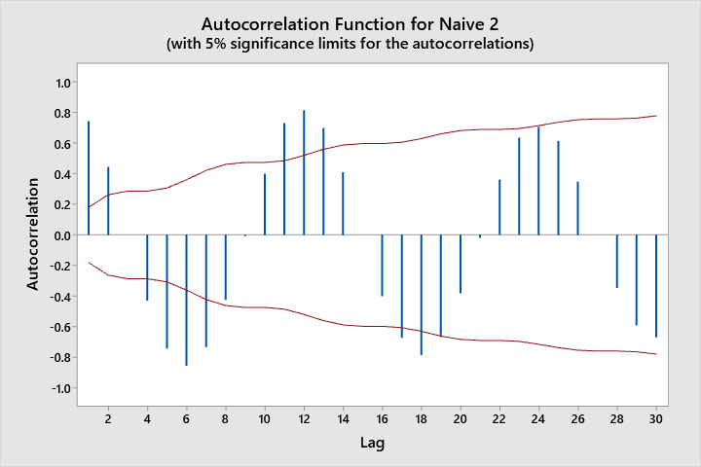
Naive Model (Trend)
Formula : Ŷ _{t + 1} = Yt+ ( Yt-Y_{t-1} )
Notes:
Naive methods are used to develop simple models that assume that very recent data provide the best predictors of the future

Slide 9
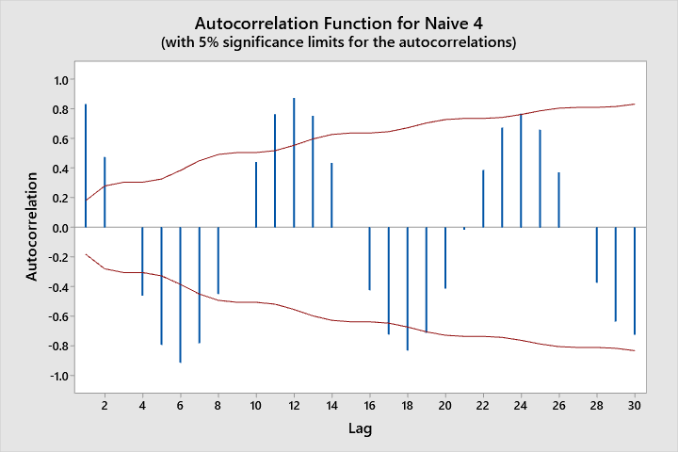
Naive Model (Seasonal)
Formula : Ŷ _{t + 1} = Y_{t-11}

Slide 10

Naive Model (Trend and Seasonality)
Formula : Ŷ _{t + 1} = Y_{t-11} + ( Y_{t} - Y_{t-12} ) / 12

Slide 11
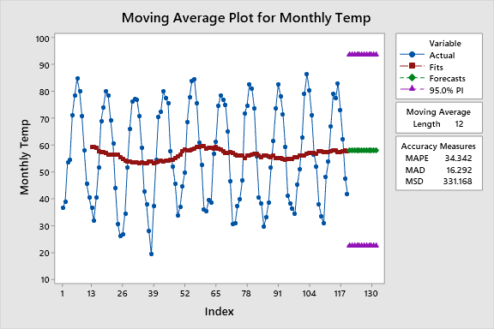
Simple Moving Averages
Notes:
The forecasted values for the next period will be nothing but sum of all items divided by number of observations is called average value

Slide 12
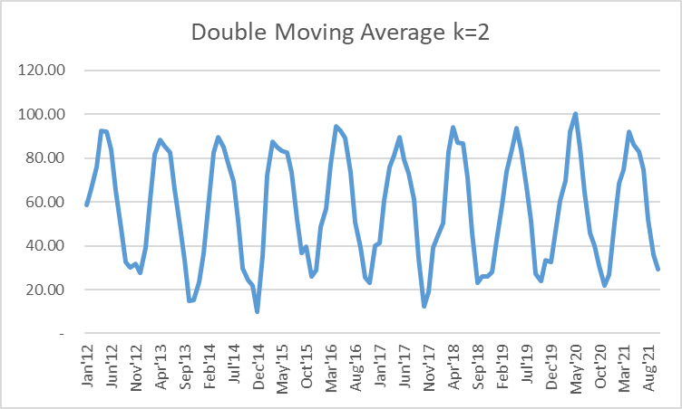
Double Moving Average
Formula :Y^=a+bp p=1
Notes:
Applies the moving average technique twice, once to the original data and then to the resulting single moving average data

Slide 13
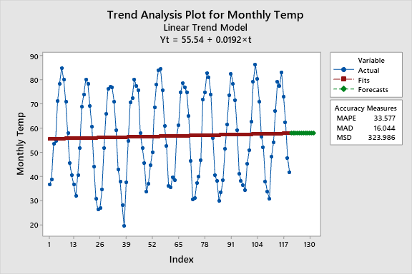
TREND ANALYSIS
Notes:
We fitted the trend and the equation came out to be
Forecasat
MSE

Slide 14
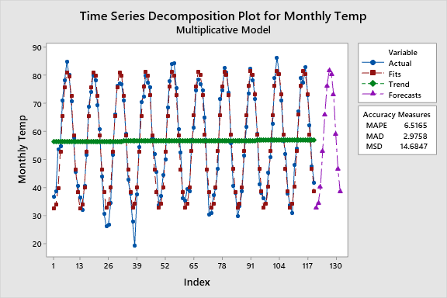
Seasonal Decomposition Multiplicative T*S
Notes:
Applied seasonal decomposition method of forecasting
Trend and Seasonal
Forecast
MSE

Slide 15
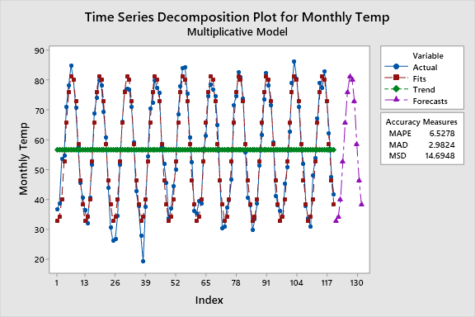
Seasonal Decomposition Multiplicative S
Notes:
Applied seasonal decomposition method of forecasting
Seasonal
Forecast
MSE

Slide 16
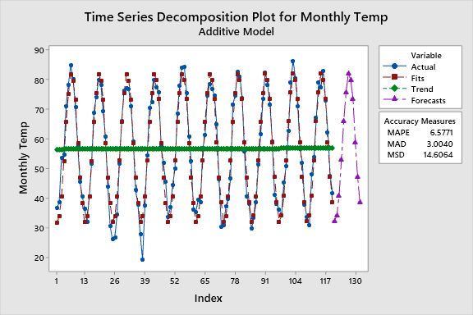
Seasonal Decomposition Additive T+S
Notes:
Applied seasonal decomposition method of forecasting
Seasonal + Trend
Forecast
MSE

Slide 17
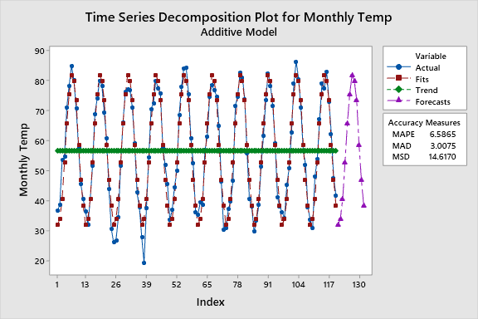
Seasonal Decomposition Additive S
Notes:
Applied seasonal decomposition method of forecasting
Seasonal
Forecast
MSE

Slide 18
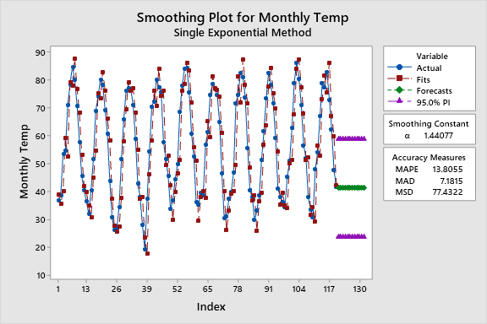
Single Exponential Smoothing
Notes:
Exponential smoothing model is a procedure which continuously revises the forecasted values in the light of more recent experience

Slide 19
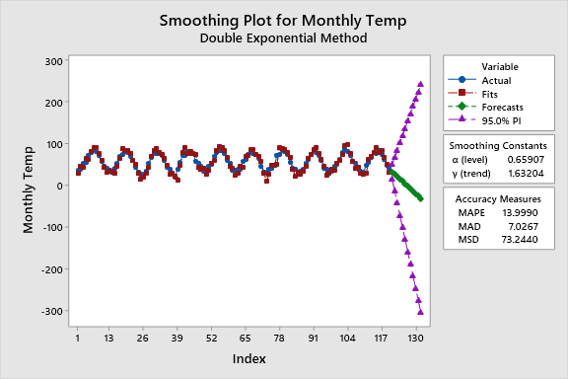
Double Exponential smoothing (Holt’s)
Notes:
Holt’s linear exponential smoothing technique, which is designed to handle data with a well‐defined trend, addresses this problem and is introduced next.
One of the advantages of Holt’s technique is that it provides a great deal of flexibility in selecting the rates at which the level and trend are tracked.

Slide 20
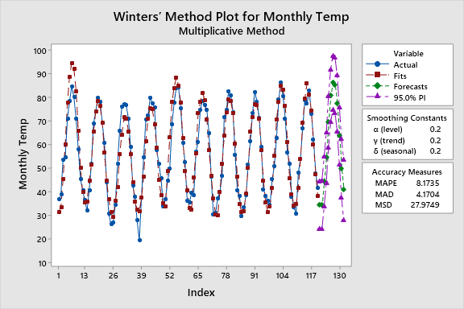
Winter’s Method
Notes:
Winter’s method is considered as an extension of Holtʹs method but it is designed to handle time series data with a well defined trend and seasonal variation.

Slide 21
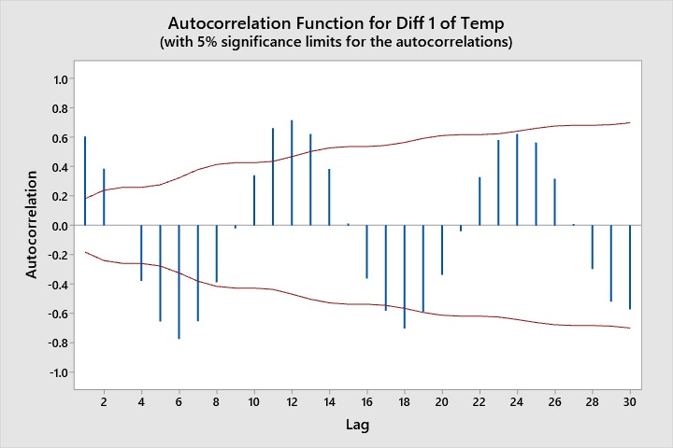
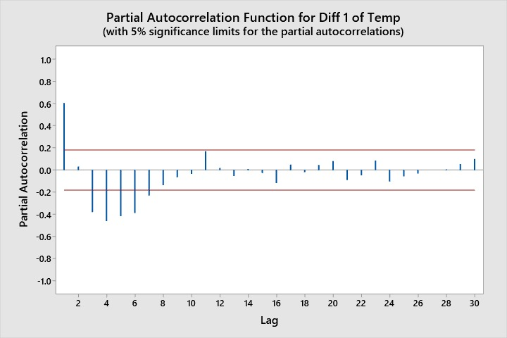
First Difference
Notes:
We are taking first diffrences because trend was present in the data and it was non stationary, in order to make stationary we took diffrences
From PACF we see AR order which is (5 (p)
From ACF we see MA order which is 4 (q)
Since we took 1 diff our d is 1
Therefore our arima is (5,1,4)

Slide 22
ARIMA (5,1,4) FORECASTS

Slide 23
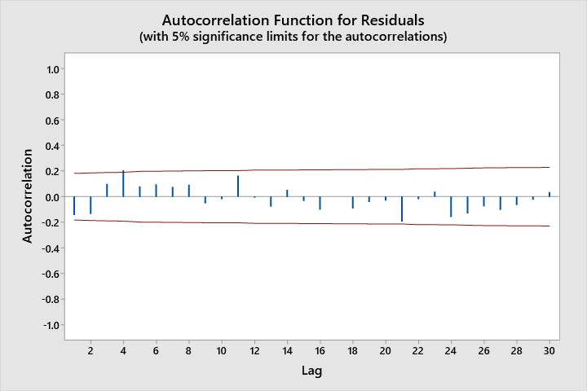
ARIMA (5,1,4)
Notes:
Residuals of arima model should be insignifanct
We get insignificant

Slide 24
Notes:
Coeffiencts used in arima equation

Slide 25
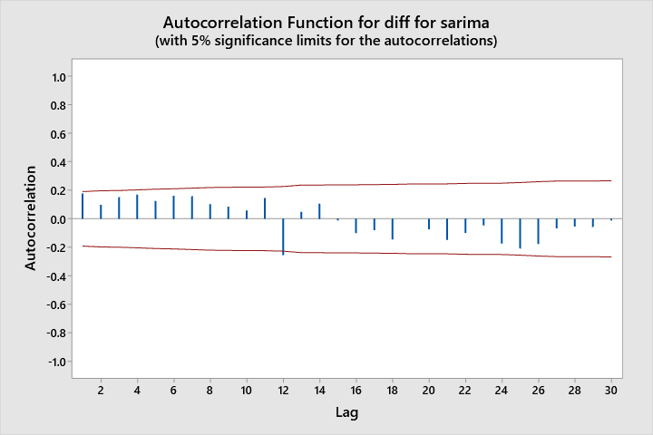
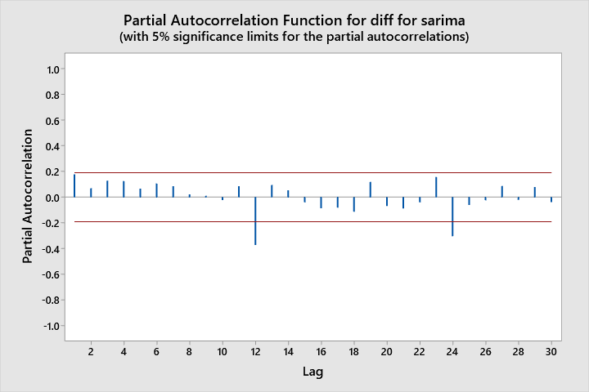
SARIMA (1,0,1)(2,1,1)
Notes:
We took differences with lag 12
Then we ran PACF on those differences to see AR order of seasonal part which is 2 (P)
From ACF on those differences; to see MA order which comes out to be is 1 (Q)
Since we took 1 diff our D is 1
Therefore our seasonal part is (2,1,1)
Next we look at acf and pacf on lags other than lags 12 and 24 and since in pacf only one is close to insignificant our p is 1
Only one in Acf is close to insigni so our q is also 1
Hence our sarima model is
(1,0,1)(2,1,1)

Slide 26
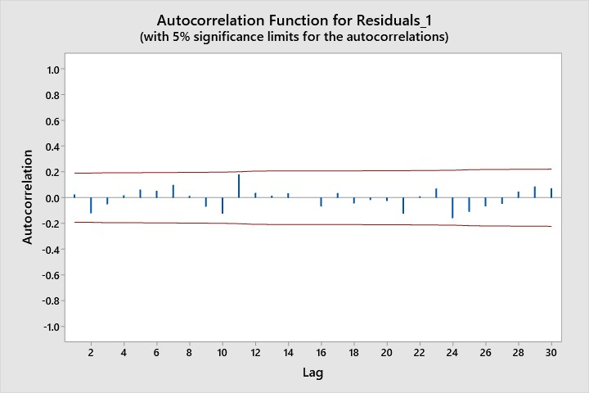
SARIMA (1,0,1)(2,1,1)
Notes:
Acf of residuals of sarima should be insign

Slide 27
Final Estimates of Parameters
Type Coef SE Coef T-Value P-Value
AR 1 0.9291 0.0988 9.40 0.000
SAR 12 -0.059 0.108 -0.54 0.590
SAR 24 -0.314 0.109 -2.87 0.005
MA 1 0.772 0.137 5.65 0.000
SMA 12 0.8966 0.0888 10.09 0.000
Constant -0.0037 0.0127 -0.29 0.774
Residual Sums of Squares
DF SS MS
102 1353.09 13.2655
Back forecasts excluded
Notes:
(1,0,1)(2,1,1)
Coefficients

Slide 28
Conclusion
Notes:
We choose the model with the lease error hence SARIMA has the least error we can say that sarima is the best forecasting model for the temperature data

